Slide 1
R Introduction
R Installation

Slide 2
Data, size, Population, Sample
About R Language
R download, installation – CRAN
R GUI
R editors
R Versions
R studio
R Files

Slide 3
DATA : facts and statistics collected together for reference or analysis.
Data analytics (DA) is the process of examining data sets in order to draw conclusions about the information they contain,
DA = business analytics
DA= Data Mining

Slide 4
Data analysis is a process of inspecting, cleansing, transforming, and modeling data with the goal of discovering useful information, informing conclusions, and supporting decision-making.

Slide 5
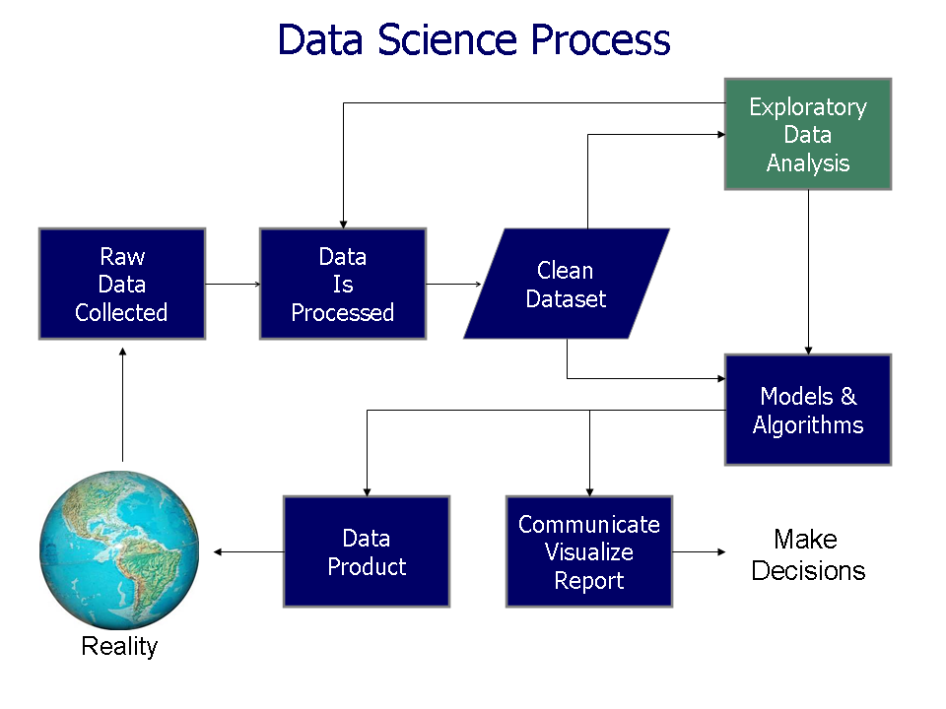

Slide 6
Population, Sample, size
a data sample is a set of data collected and/or selected from a statistical population by a defined procedure.
Observe: Sample need procedure. Not just like that, u can choose sample.
Typically, the population is very large, making a census or a complete enumeration of all the values in the population either impractical or impossible.

Slide 7
sample
The sample usually represents a subset of manageable size.
Samples are collected and statistics are calculated from the samples, so that one can make inferences or extrapolations from the sample to the population.

Slide 8
R Program Originated from “S” Language
S by Rick Becker of Bell Labs
Integrates suite of software
R by Ross Ihaka, Robert Gentleman ( R)
First in 1993. stable version from 2000
General Public License
Free cost

Slide 9
R Installation
Download from https://cran.r-project.org/bin/windows/base/
Appropriate OS. ( windows /Linux/ Mac )
Windows 32/64 bit
64bit is high performance, Recommended
https://cran.r-project.org/doc/manuals/r-release/R-intro.pdf

Slide 10
Comprehensive R Archive Network
https://cran.r-project.org/

Slide 11
Command Line Interface
GUI
IDE ( Editors) : Notepad++, Eclipse, Pycharm
Includes C,C++.Java, .NET, Python
Statistical Computing
On Various OS . OS independent
Interpret language

Slide 12
R version 3+
3, 3,4,3.5 stable versions
Hadoop Extension to R
Oracle Extension to R
SQl server extension to R
Linux – Debian, Redhat, Suse, Ubuntu
Mac Osx - 10

Slide 13
R studio download
https://www.rstudio.com/products/rstudio/download/
R studio Desktop (RStudio 1.1.453 - Windows Vista/7/8/10)
R studio server ( works only in Linux)
R- shiny
https://rstudio.cloud/ ( Cloud – Azure, AWS etc)
C:\R\R-3.5.0

Slide 14
R in scripts with .R ,.r,.Rda
Source(“/path/file.R”)
Sink for output
Interactive in CMD line

Slide 15
Validate
G to R Gui
> R.Version()
> getwd()
To Locate current working directory path
C:/Users/radhapavan/Documents

